Slide 1






Zeal IT Consultants
SDLC – Development
Notes:
Everything we do revolves around the SDLC What is an SDLC and why is it important – its outcomes Show you an example of how it was used

Slide 2

Vijay Thomas Oommen
Zealer since 2023
Worked at many consulting shops – Headspring, Slalom, LogicaCMG (now CGI)
Also worked in the Airline, Healthcare, Retail and Banking Industry
In my free time, I play the piano and the guitar, besides gardening

Slide 3

Understanding Client Needs
Notes:
Client needs can be: Contradicting
Vague
Need more research or study
Do we have sufficient data
Does it fit the political hierarchy

Slide 4

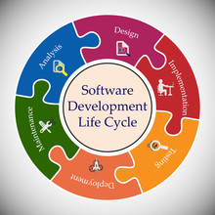
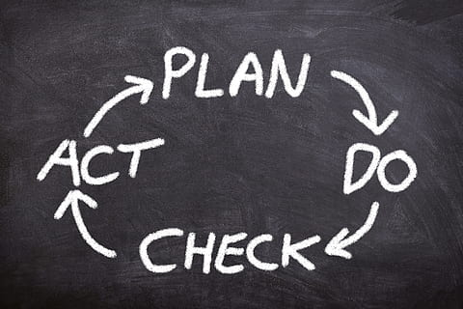
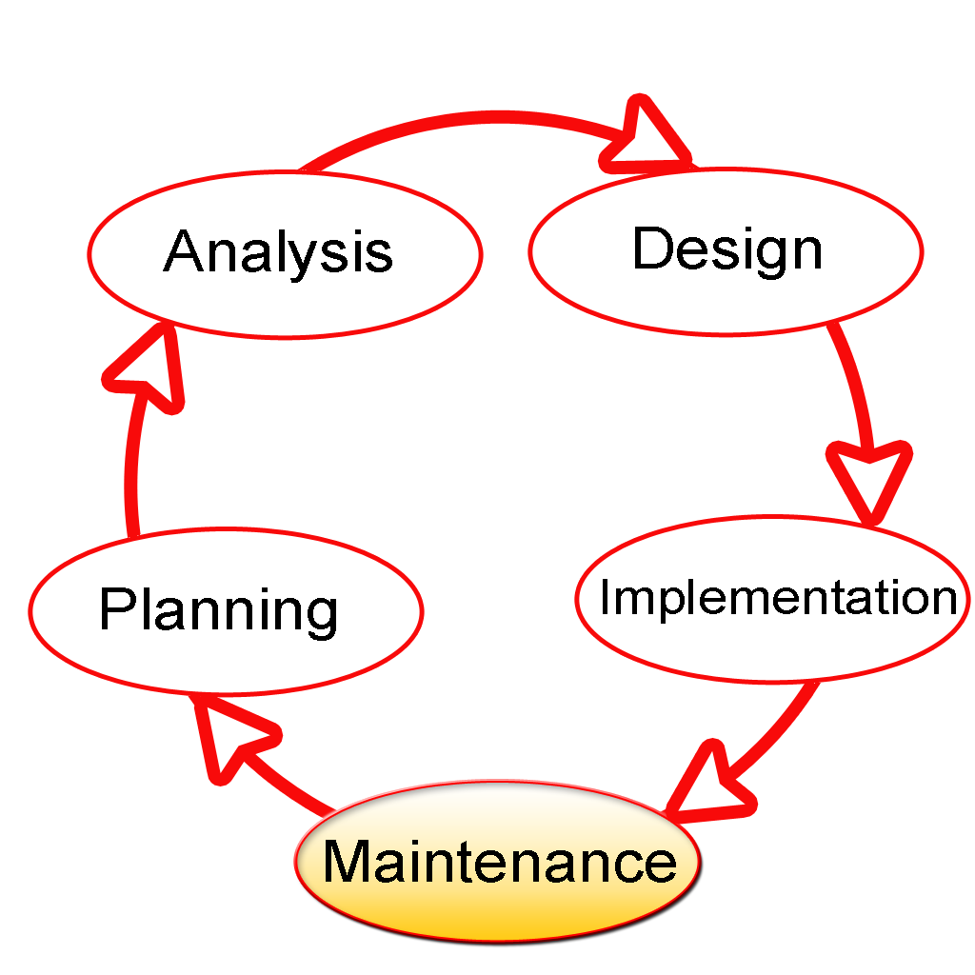


SDLC – What!
Structured Process to understand client needs to develop software
A sequence of Phases, like planning, analysis, creating and testing
Goals
High Quality Software
Meet or exceed customer expectation
Achieves timelines and cost estimates
Maintainable and scalable
Generate Business Value
Notes:
Maintainable and scalable: Software should be an asset and not a liability We shouldn’t spend more on the software than we get from it.

Slide 5
SDLC – Tell me more…
Delivery Business Value
Determine Goals/Business value, allocate resources, work out a schedule, costs and risks
Planning
Operational Support/Enhancements
Support
Analysis
Dive into details – talk to people, analyze existing data, review existing systems – Requirements or stories
Deploy to production (pilot), setup monitoring tools and telemetry – delivering the product
Deploy
Design
UI Design, System design (architecture)
Thorough testing to find defects, in order to ensure that delivery of business value
Coding according to design and architecture
Testing
Develop
Understanding Clients Needs
Notes:
Operational Support -> example: Ergonomics example: Save button at the bottom of them form Remember this slide - quiz/game

Slide 6


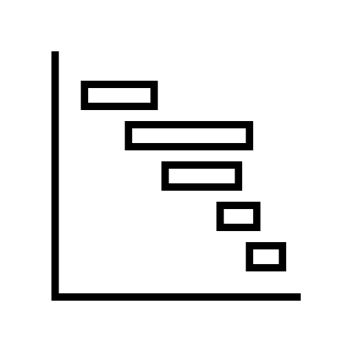
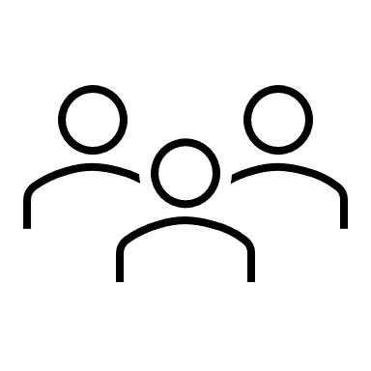











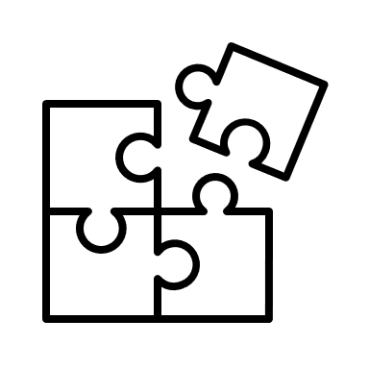

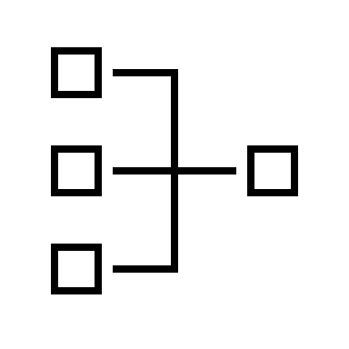



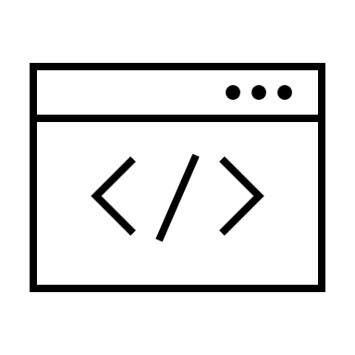
The Proof of the Pudding…
Cost estimates Project
Plan and project Team
Support, update, bugfix, enhance
Planning
Support
Analysis
Interviews,
data/doc -
produce stories
Deploy, monitor, telemetry
Deploy
Design
Prototype,
architecture,
templates
Testing
Develop
Defects, fixes
Code / software
Notes:
Everything is judged by its outcome templates => stylesheets/css, style guides
Iterations

Slide 7
Flavors
Liner & Sequential – complete each phase before starting the next
Waterfall
Iterative, incremental approach. Emphasizes flexibility,
customer feedback, rapid delivery and functional pieces
Agile
Start with some requirements, then test and evaluate and further define and repeat
Iterative
Dev and Ops teams work together.
Relies on continuous feedback and process improvement.
DevOps
Notes:
Waterfall – construction of a house. For a foundation, we need plumbing, for the plumbing, we need the rooms
Agile – Product catalog, then login screen, now enhance the product catalog to show preferences of the logged in user
Iterative – recall notice to customers, then capture customer acknowledgement
DevOps – ecommerce site on a browser, poor response on a mobile device, enhance mobile site.

Slide 8
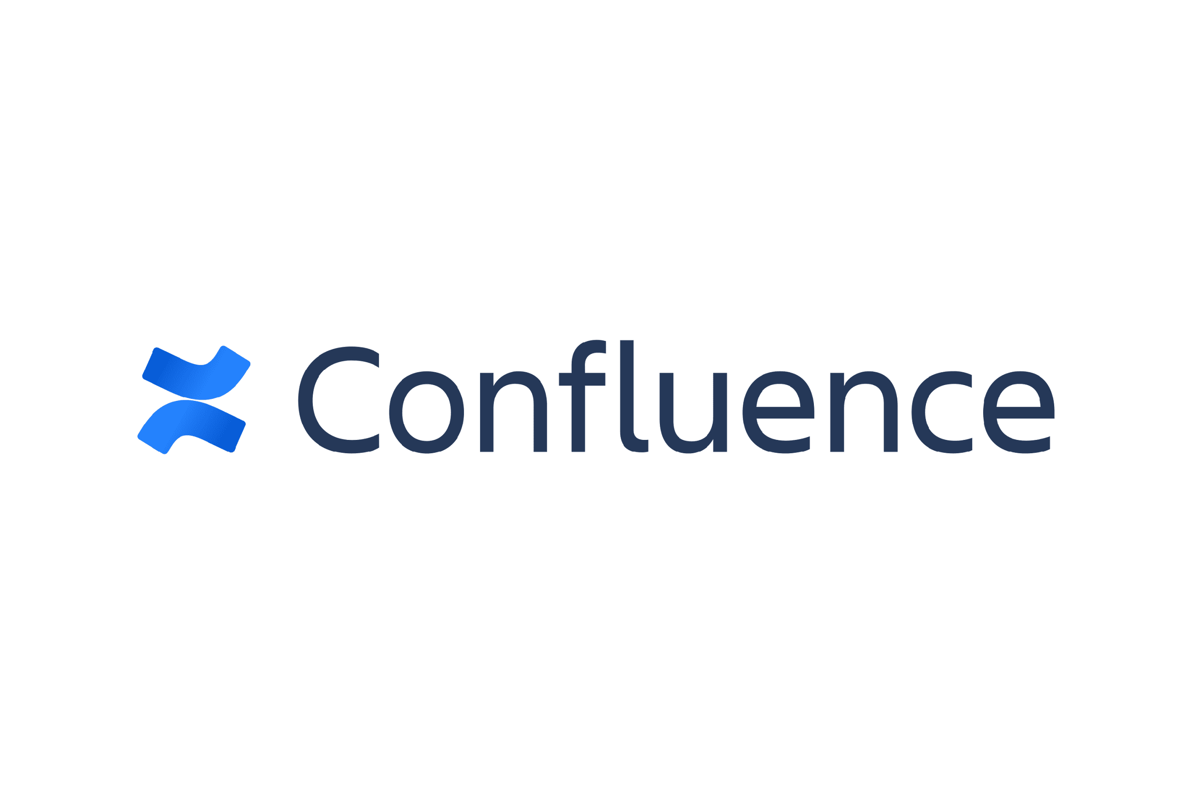

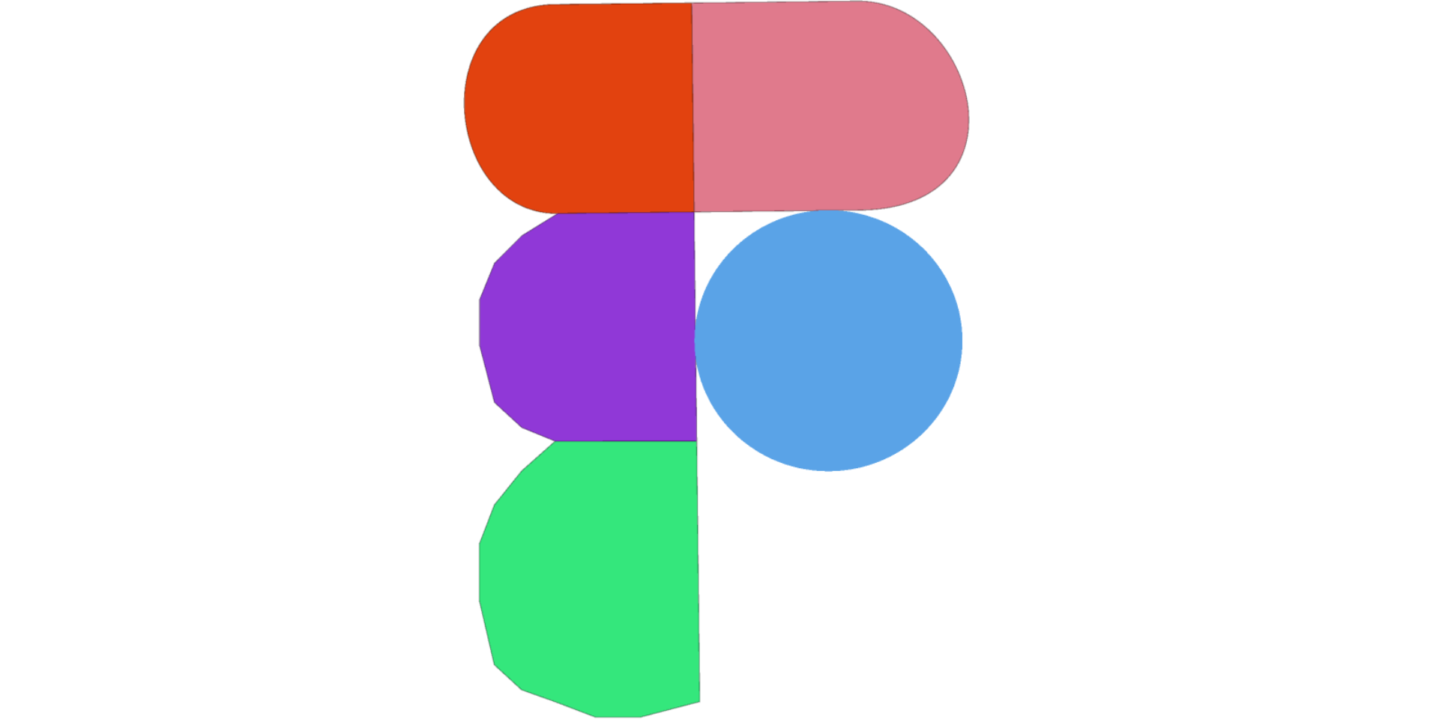



Learn by example – Client Portal
Planning & Analysis:
Requirements
Testing
Deployment
Design: Prototype
Website
Code

Slide 9
Zeal IT Consultants
Whatever you do,
do it with Zeal.

